Slide 1
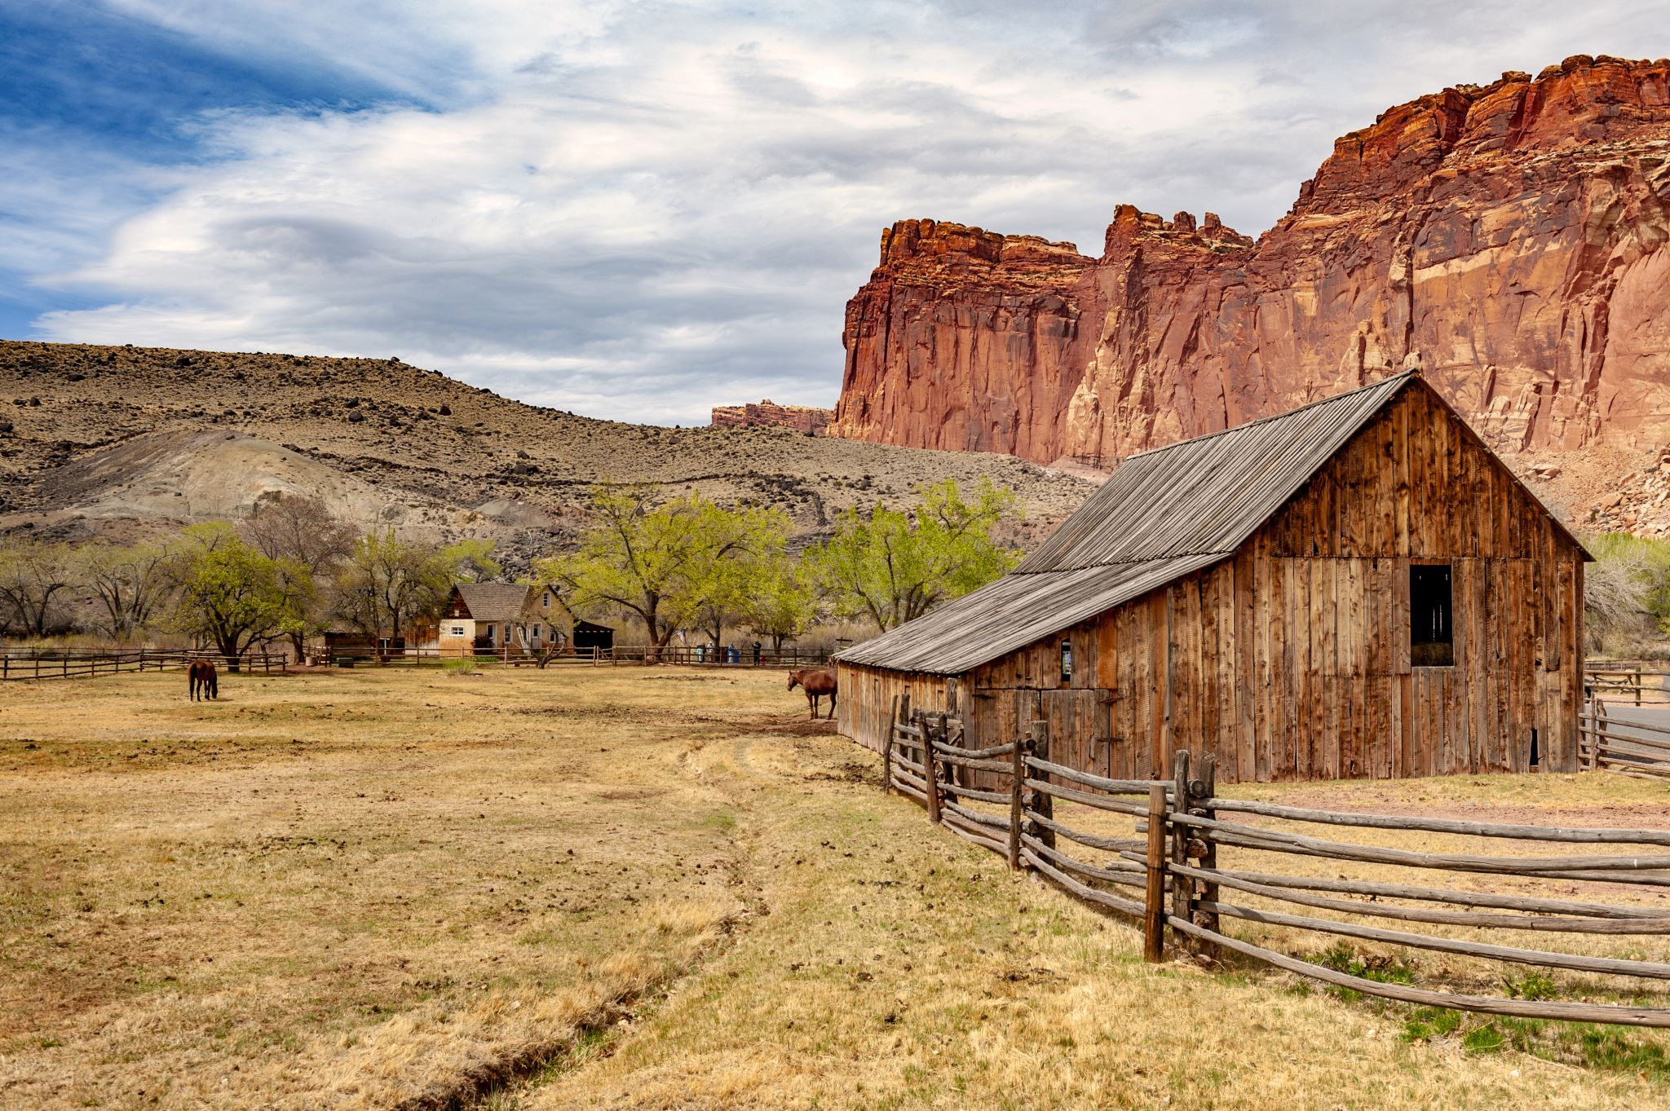

King County
Price Prediction

Slide 2

Business Problem
Horizon Home (HH) - Real Estate Agency
Build a model which will help HH to make informed investment decisions
Make data driven conclusion about housing prices

Slide 3
METHODOLOGY
Obtain & analyse Dataset
Investigate Features
Build Predictive MODEL
Conclusion & recommendations

Slide 4
OBTAIN & ANALYSE DATASET
Data scrubbing:
Investigating the names of the columns, dataset shape and size.
Removing incomplete, incorrect, inaccurately formatted or repeated data.
Adding and replacing columns.
Removing columns we no longer need for our model.

Slide 5
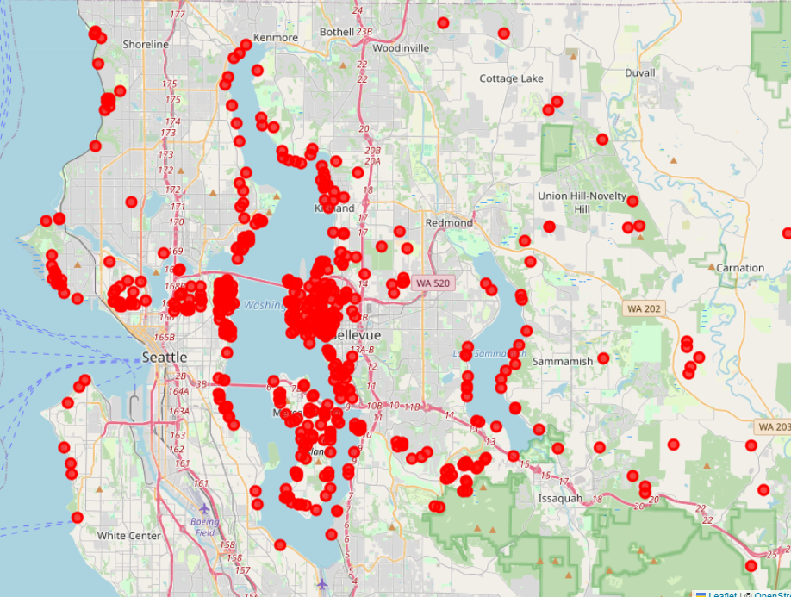
OBTAIN & ANALYSE DATASET
The most expensive properties are located around Lake Washington near cities Bellevue, Medina, Seattle and Mercer Island and those near water complimenting feature “waterfront”

Slide 6
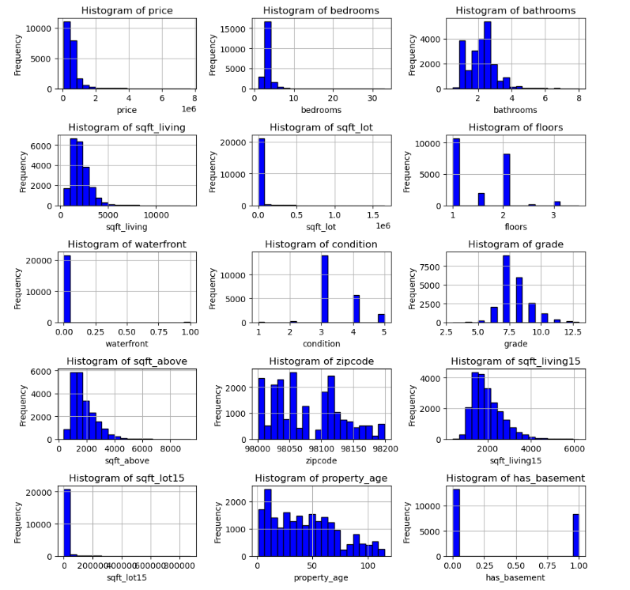
INVESTIGATE FEATURES
Distribution Histogram
Bedrooms
Bathrooms

Slide 7
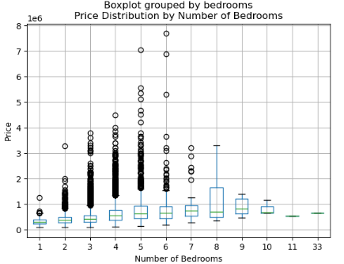
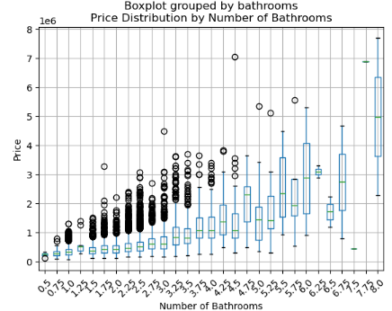
INVESTIGATE FEATURES
Getting rid of outliers using Z-score

Slide 8
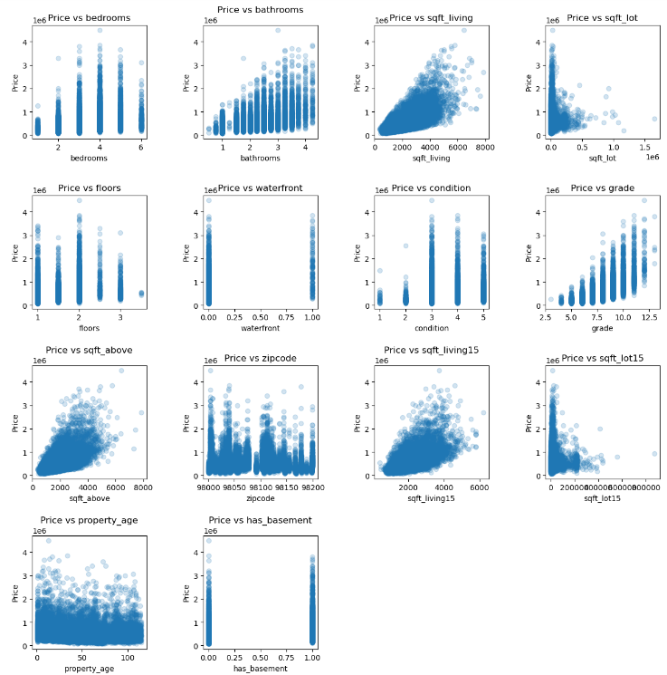
INVESTIGATE FEATURES
Closer look required to “sqft_lot” and “sqft_lot15” features since the linearity is not obvious

Slide 9
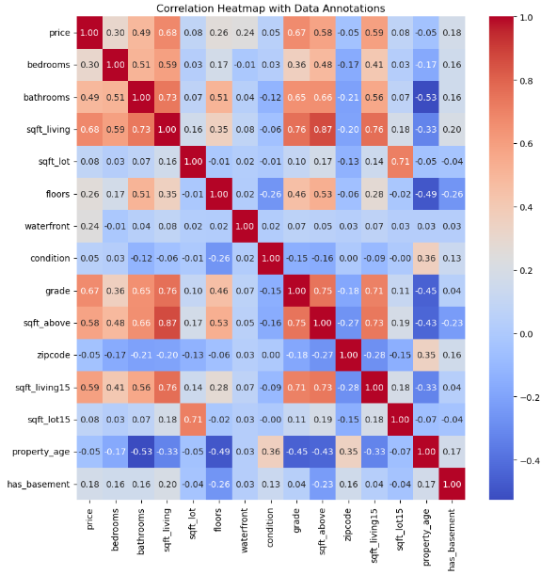
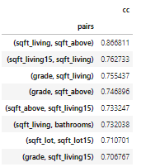
INVESTIGATE FEATURES
Signs of the Multicollinearity.
Some of the features removed from the model.

Slide 10
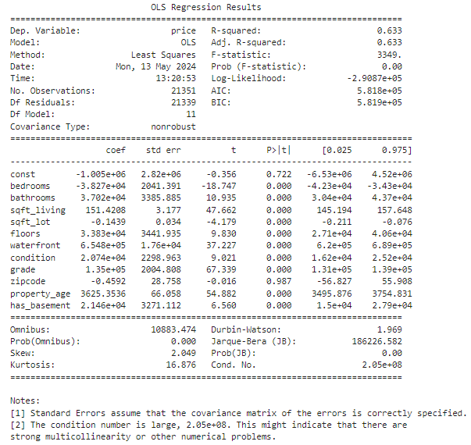
BUILD PREDICTION MODEL
Steps to improve model
R-squared 0.63.
Zipcode P-value is insignificant (>0.05), we replaced zipcode with the actual city name.
Created dummy variables for categorical variables.
Did Log transformation for some of the numerical variables.

Slide 11
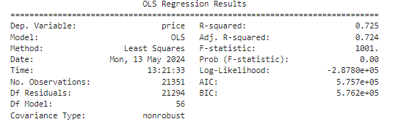
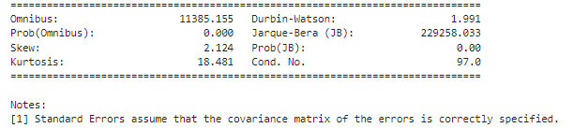
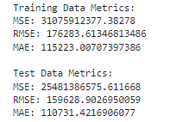
BUILD PREDICTION MODEL
Final Model
Key Features
R-squared - 0.725.
F-statistic – 1001.
Prob (F-statistic) – 0.00.
No. of conditions - 97.0.
P-values are significant.
RMSE on Train data is slightly higher than RMSE on Test data (within 10% bracket – model is not overfitted.
Training and Test Error metrics are reasonable and smaller than standard deviation.

Slide 12
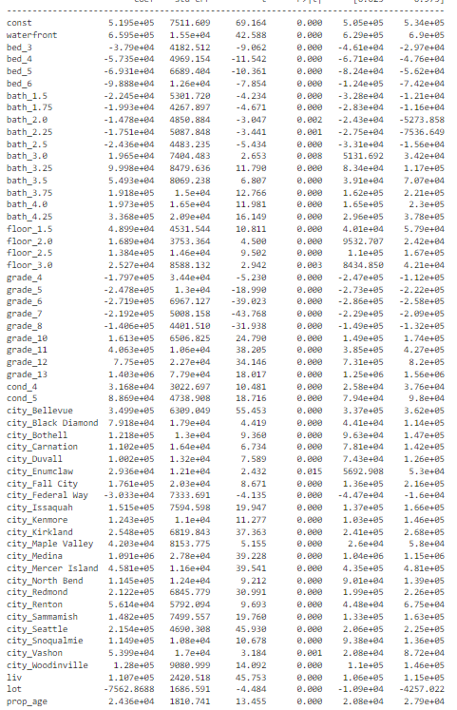
Conclusion
CONCLUSION
Key features with strong influence
Waterfront house gets us increase of $659,500 in house price.
Higher Grade brings significant house price increase from $160k for grade 10 to $1.4 mil for grade 13.
House in Bellevue would get additional $350k as well as house in Medina would get us over $1 mil.
Over 3 bathrooms will get us from $20k to $336k increase in average.
Number of bedrooms is not representative, however each additional sqft living will get us $111k increase.

Slide 13
RECOMMENDATIONS
Invest in the waterfront houses.
Invest in the houses with the higher grade, especially those with the grade over 10.
Invest in the houses near water such as Bellevue and Medina.
Invest in properties with 3 and more bathrooms.
Invest into the houses with the higher sqft_living (not necessarily higher number of bedrooms).

Slide 14

THANK YOU
Email: grigorenko.jane@gmail.com
GitHub: https://github.com/JaneGrig
LinkedIn: linkedin.com/in/evgeniya-jane-grigorenko-47692211b

